Slide 1
Packages & Interfaces
Prepared using following Resources:
Herbert Schildt, “Java: The Complete Reference”, Tata McGrawHill Education
E Balagurusamy, Programming with Java - A Tata McGraw Hill Education
https://www.geeksforgeeks.org/java/
https://www.javatpoint.com/java-tutorial
https://www.tutorialspoint.com/java/index.htm
https://www.w3schools.com/java/
By: DIVAKARA .N

Slide 2
Packages: Defining a Package, Finding Packages and CLASSPATH, Access Protection, Importing Packages.
Interfaces: Defining an Interface, Implementing Interfaces, Nested Interfaces, Applying Interfaces, Variables in Interfaces, Interfaces Can Be Extended.

Slide 3
Packages:
  Defining a Package
  Finding Packages and CLASSPATH
  Access Protection
  Importing Packages
Interfaces:
  Defining an Interface
  Implementing Interfaces
  Nested Interfaces Applying Interfaces
  Variables in Interfaces
  Interfaces Can Be Extended

Slide 4
  Basics:
Packages are containers for classes that are used to keep the class name space compartmentalized.
Eg: A package allows you to create a class named List, which you can store in your own package without concern that it will collide with some other class named List stored elsewhere.
Packages are stored in a hierarchical manner and are explicitly imported into new class definitions.
A Java’s mechanism for partitioning the class name space into more manageable chunks.

Slide 5
  Basics: ...
The package is both a naming and a visibility control mechanism.
One can define classes inside a package that are not accessible by code outside that package.
Also define class members that are only exposed to other members of the same package.
This allows your classes to have intimate knowledge of each other, but not expose that knowledge to the rest of the world.

Slide 6
  Basics: ...
The benefits of organising classes into packages are:
  The classes contained in the packages of other programs/applications can be reused.
  In packages classes can be unique compared with classes in other packages. That two classes in two different packages can have the same name. If there is a naming clash, then classes can be accessed with their fully qualified name.
  Classes in packages can be hidden if we don’t want other packages to access them.
  Also provide a way for separating “design” from coding.
  Packages enable grouping of functionally related classes.

Slide 7
  Basics: ...
The Java Foundation Packages
Java provides a large number of classes groped into different packages based on their functionality.
The six foundation Java packages are:
  java.lang: Classes for primitive types, strings, math functions, threads, and exception
  java.util: Classes such as vectors, hash tables, date etc.
  java.io: Stream classes for I/O
  java.awt: Classes for implementing GUI – windows, buttons, menus etc.
  java.net: Classes for networking
  java.applet: Classes for creating and implementing applets

Slide 8
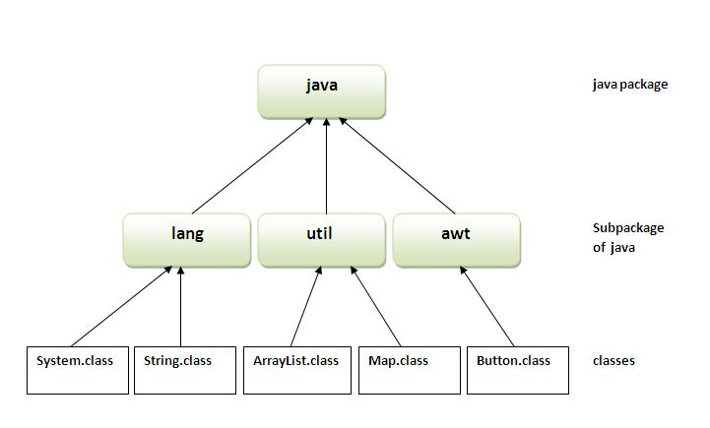
  Basics: ...
The Java Foundation Packages

Slide 9
  Defining a Package:
Include a package command as the first statement in a Java source file. Any classes declared within that file will belong to the specified package.
The package statement defines a name space in which classes are stored. If you omit the package statement, the class names are put into the default package, which has no name.
While the default package is fine for short, sample programs, it is inadequate for real applications. Most of the time, you will define a package for your code.
General Form: package pkg; Eg: package MyPackage;

Slide 10
  Defining a Package: ...
Java uses file system directories to store packages. For example, the .class files for any classes you declare to be part of MyPackage must be stored in a directory called MyPackage.
Remember that case is significant, and the directory name must match the package name exactly.
More than one file can include the same package statement. The package statement simply specifies to which package the classes defined in a file belong. It does not exclude other classes in other files from being part of that same package.
Most real-world packages are spread across many files.

Slide 11
  Defining a Package: ...
You can create a hierarchy of packages. To do so, simply separate each package name from the one above it by use of a period. The general form of a multileveled package statement package pkg1[.pkg2[.pkg3]];
A package hierarchy must be reflected in the file system of your Java development system.
Eg: A package declared as package java.awt.image; needs to be stored in java\awt\image in a Windows environment.
Be sure to choose your package names carefully. You cannot rename a package without renaming the directory in which the classes are stored.

Slide 12
  Finding Packages and CLASSPATH:
Packages are mirrored by directories. This raises an important question: How does the Java run-time system know where to look for packages that you create?
The answer has three parts.
  First, by default, the Java run-time system uses the current working directory as its starting point. Thus, if your package is in a subdirectory of the current directory, it will be found.
  Second, you can specify a directory path or paths by setting the CLASSPATH environmental variable.
  Third, you can use the -classpath option with java and javac to specify the path to your classes.

Slide 13
  Finding Packages and CLASSPATH: ...
Eg: package MyPack; In order for a program to find MyPack, one of three things must be true.
  Either the program can be executed from a directory immediately above MyPack, or
  the CLASSPATH must be set to include the path to MyPack, or
  the -classpath option must specify the path to MyPack when the program is run via java.
When the second two options are used, the class path must not include MyPack, itself. It must simply specify the path to MyPack. For example, in a Windows environment, if the path to MyPack is C:\MyPrograms\Java\MyPack Then the class path to MyPack is C:\MyPrograms\Java\MyPack

Slide 14
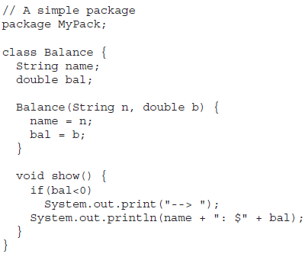
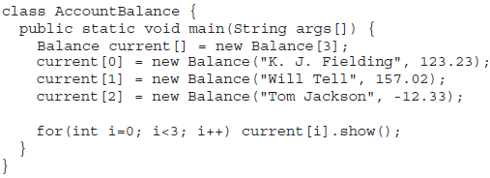
  Finding Packages and CLASSPATH: ...
A Short Package Example
Call this file AccountBalance.java and put it in a directory called MyPack. Next, compile the file. Make sure that the resulting .class file is also in the MyPack directory. Then, try executing the AccountBalance class, using the following command line:
java MyPack.AccountBalance
Remember, you will need to be in the directory above MyPack when you execute this command.
AccountBalance is now part of the package MyPack. This means that it cannot be executed by itself.

Slide 15
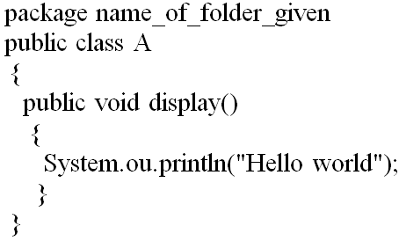
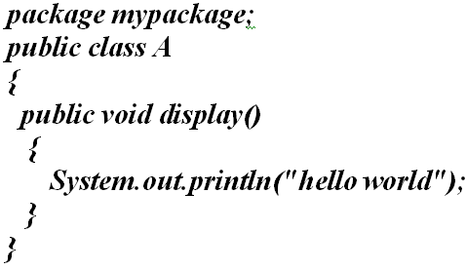
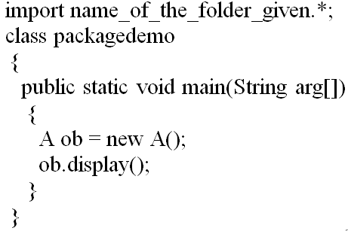
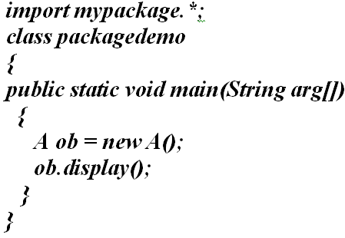
  Finding Packages and CLASSPATH: ...
A Short Package Example ...

Slide 16
  Access Protection:
Packages add another dimension to access control. Java provides many levels of protection to allow fine-grained control over the visibility of variables and methods within classes, subclasses, and packages.
Classes and packages are both means of encapsulating and containing the name space and scope of variables and methods.
Packages act as containers for classes and other subordinate packages.
Classes act as containers for data and code. The class is Java’s smallest unit of abstraction.

Slide 17
  Access Protection: ...
Because of the interplay between classes and packages, Java addresses four categories of visibility for class members:
  Subclasses in the same package
  Non-subclasses in the same package
  Subclasses in different packages
  Classes that are neither in the same package nor subclasses
The three access specifiers, private, public, and protected, provide a variety of ways to produce the many levels of access required by these categories.

Slide 18
  Access Protection: ...
While Java’s access control mechanism may seem complicated, we can simplify it as follows:
  Anything declared public can be accessed from anywhere.
  Anything declared private cannot be seen outside of its class.
  When a member does not have an explicit access specification, it is visible to subclasses as well as to other classes in the same package. This is the default access.
  If you want to allow an element to be seen outside your current package, but only to classes that subclass your class directly, then declare that element protected.

Slide 19
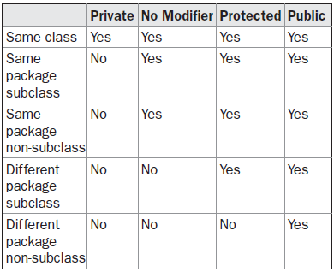
  Access Protection: ...
Class Member Access - Applies only to members of classes.
A non-nested class has only two possible access levels: default and public. When a class is declared as public, it is accessible by any other code.
If a class has default access, then it can only be accessed by other code within its same package.
When a class is public, it must be the only public class declared in the file, and the file must have the same name as the class.

Slide 20
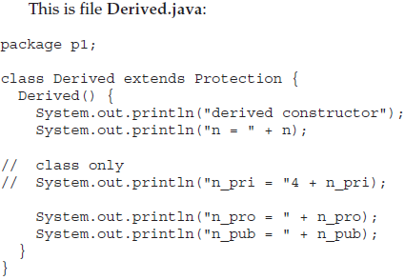
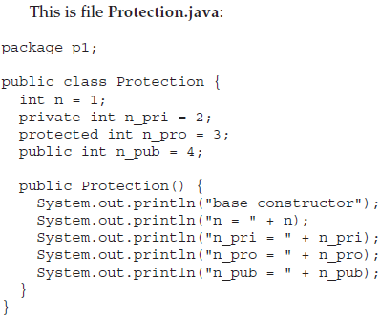
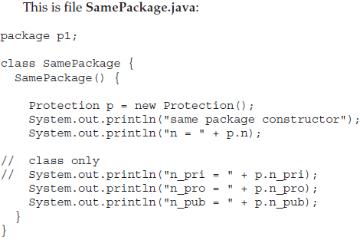
  Access Protection: ...
An Access Example

Slide 21
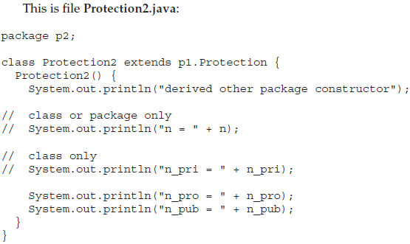
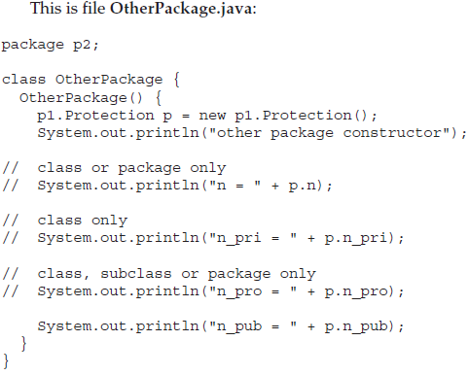
  Access Protection: ...
An Access Example ...

Slide 22
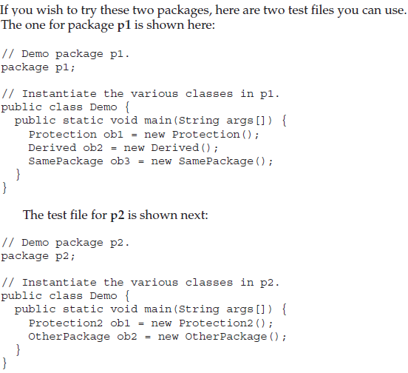
  Access Protection: ...
An Access Example ...

Slide 23
  Importing Packages:
Given that packages exist and are a good mechanism for compartmentalizing diverse classes from each other, it is easy to see why all of the built-in Java classes are stored in packages.
There are no core Java classes in the unnamed default package; all of the standard classes are stored in some named package. Since classes within packages must be fully qualified with their package name or names, it could become tedious to type in the long dot-separated package path name for every class you want to use.
For this reason, Java includes the import statement to bring certain classes, or entire packages, into visibility. Once imported, a class can be referred to directly, using only its name.

Slide 24
  Importing Packages: ...
The import statement is a convenience to the programmer and is not technically needed to write a complete Java program. If you are going to refer to a few dozen classes in your application, however, the import statement will save a lot of typing.
In a Java source file, import statements occur immediately following the package statement (if it exists) and before any class definitions. The general form of the import statement:
import pkg1[.pkg2].(classname|*);
Here, pkg1 is the name of a top-level package, and pkg2 is the name of a subordinate package inside the outer package separated by a dot (.).

Slide 25
  Importing Packages: ...
There is no practical limit on the depth of a package hierarchy, except that imposed by the file system. Finally, you specify either an explicit classname or a star (*), which indicates that the Java compiler should import the entire package.
This code fragment shows both forms in use:
      import java.util.Date;
      import java.io.*;
CAUTION The star form may increase compilation time-especially if you import several large packages. For this reason it is a good idea to explicitly name the classes that you want to use rather than importing whole packages. However, the star form has absolutely no effect on the run-time performance or size of your classes.

Slide 26
  Importing Packages: ...
All of the standard Java classes included with Java are stored in a package called java.
The basic language functions are stored in a package inside of the java package called java.lang
Normally, you have to import every package or class that you want to use, but since Java is useless without much of the functionality in java.lang, it is implicitly imported by the compiler for all programs. This is equivalent to the following line being at the top of all of your programs: import java.lang.*;
If a class with the same name exists in two different packages that you import using the star form, the compiler will remain silent, unless you try to use one of the classes. In that case, you will get a compile-time error and have to explicitly name the class specifying its package.

Slide 27
  Importing Packages: ...
It must be emphasized that the import statement is optional. Any place you use a class name, you can use its fully qualified name, which includes its full package hierarchy.
For example, this fragment uses an import statement:
  import java.util.*;
  class MyDate extends Date {
  }
The same example without the import statement looks like this:
  class MyDate extends java.util.Date {
  }
In this version, Date is fully-qualified.

Slide 28
  Importing Packages: ...
When a package is imported, only those items within the package declared as public will be available to non-subclasses in the importing code.
For example, if you want the Balance class of the package MyPack shown earlier to be available as a stand-alone class for general use outside of MyPack, then you will need to declare it as public and put it into its own file.

Slide 29
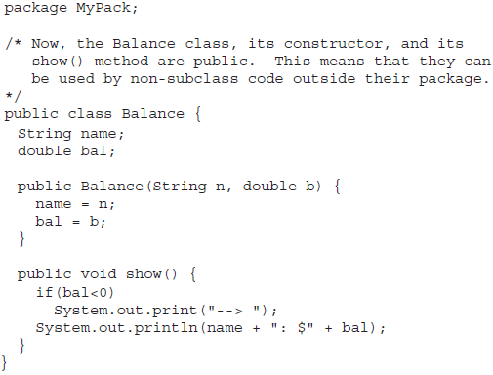
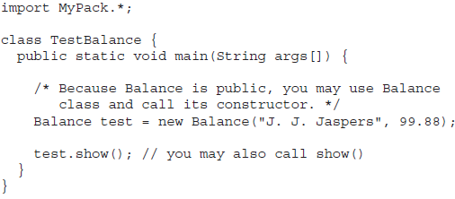
  Importing Packages: ...

Slide 30
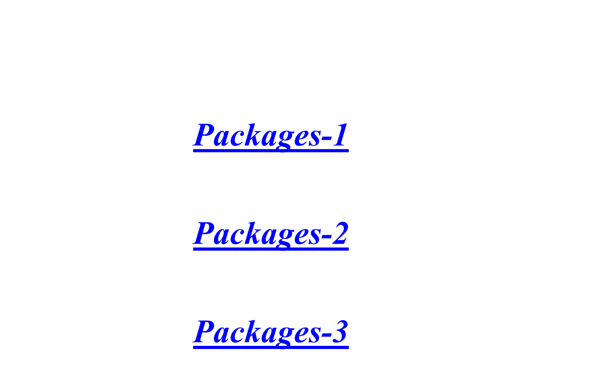

Slide 31
  Basics:
Through the use of the interface keyword, Java allows you to fully abstract the interface from its implementation.
Using interface, you can specify a set of methods that can be implemented by one or more classes. The interface, itself, does not actually define any implementation.
Although they are similar to abstract classes, interfaces have an additional capability: A class can implement more than one interface. By contrast, a class can only inherit a single superclass (abstract or otherwise).

Slide 32
  Basics: ...
Using the keyword interface, you can fully abstract a class’ interface from its implementation. Also you can specify what a class must do, but not how it does it.
Interfaces are syntactically similar to classes, but they lack instance variables, and their methods are declared without any body.
Once it is defined, any number of classes can implement an interface. Also, one class can implement any number of interfaces.

Slide 33
  Basics: ...
To implement an interface, a class must create the complete set of methods defined by the interface. However, each class is free to determine the details of its own implementation.
By providing the interface keyword, Java allows you to fully utilize the “one interface, multiple methods” aspect of polymorphism.
Interfaces are designed to support dynamic method resolution at run time.
NOTE Interfaces add most of the functionality that is required for many applications that would normally resort to using multiple inheritance in a language such as C++.

Slide 34
  Basics: ...
Why use Java interface? There are mainly three reasons:
  It is used to achieve fully abstraction.
  By interface, we can support the functionality of multiple inheritance.
  It can be used to achieve loose coupling.
The java compiler adds public and abstract keywords before the interface method and public, static and final keywords before data members.

Slide 35
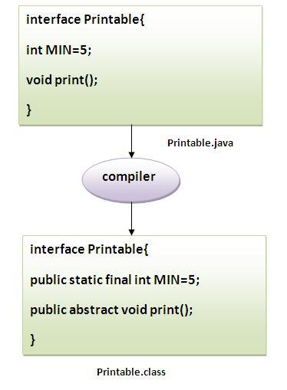
  Basics: ...
Why use Java interface? There are mainly three reasons:
  It is used to achieve fully abstraction.
  By interface, we can support the functionality of multiple inheritance.
  It can be used to achieve loose coupling.
The java compiler adds public and abstract keywords before the interface method and public, static and final keywords before data members.

Slide 36
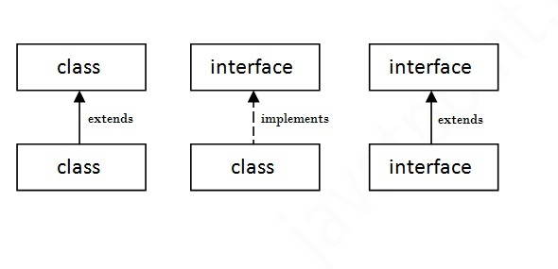
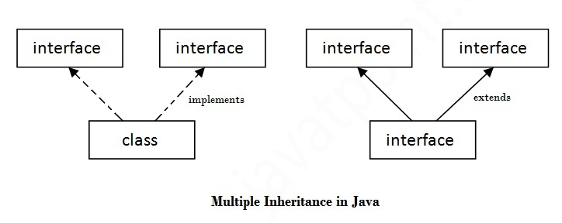
  Basics: ...
Understanding relationship between classes and interfaces
Multiple inheritance in Java by interface

Slide 37
  Defining an Interface:
An interface is defined much like a class. The General form:
  access interface name {
    return-type method-name1(parameter-list);
    return-type method-name2(parameter-list);
    type final-varname1 = value;
    type final-varname2 = value;
    // ...
    return-type method-nameN(parameter-list);
    type final-varnameN = value;
  }
When no access specifier is included, then default access results, and the interface is only available to other members of the package in which it is declared. When it is declared as public, the interface can be used by any other code. In this case, the interface must be the only public interface declared in the file, and the file must have the same name as the interface.

Slide 38
  Defining an Interface: ...
Notice that the methods that are declared have no bodies. They end with a semicolon after the parameter list. They are, essentially, abstract methods; there can be no default implementation of any method specified within an interface.
Each class that includes an interface must implement all of the methods.
Variables can be declared inside of interface declarations. They are implicitly final and static, meaning they cannot be changed by the implementing class. They must also be initialized.
All methods and variables are implicitly public.

Slide 39

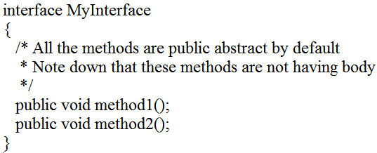
  Defining an Interface: ...
Examples:

Slide 40

  Implementing Interfaces:
Once an interface has been defined, one or more classes can implement that interface.
To implement an interface, include the implements clause in a class definition, and then create the methods defined by the interface.
If a class implements more than one interface, the interfaces are separated with a comma. If a class implements two interfaces that declare the same method, then the same method will be used by clients of either interface.
The methods that implement an interface must be declared public. Also, the type signature of the implementing method must match exactly the type signature specified in the interface definition.

Slide 41
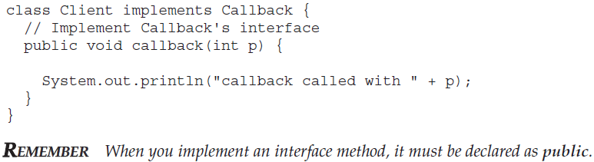
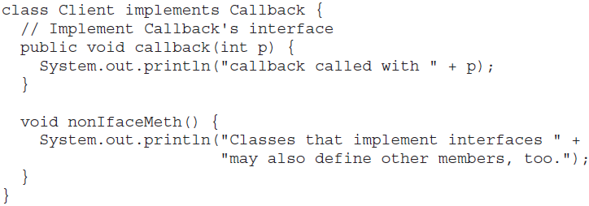
  Implementing Interfaces: ...
It is both permissible and common for classes that implement interfaces to define additional members of their own.

Slide 42
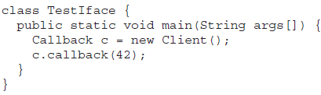
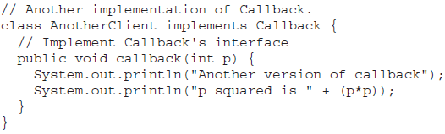
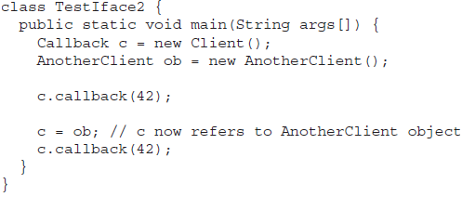
  Implementing Interfaces: ...
Accessing Implementations Through Interface References

Slide 43
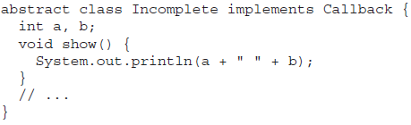
  Implementing Interfaces: ...
Partial Implementations
If a class includes an interface but does not fully implement the methods defined by that interface, then that class must be declared as abstract.
Here, the class Incomplete does not implement callback( ) and must be declared as abstract.
Any class that inherits Incomplete must implement callback( ) or be declared abstract itself.

Slide 44
  Nested Interfaces:
An interface can be declared a member of a class or another interface. Such an interface is called a member interface or a nested interface.
A nested interface can be declared as public, private, or protected. This differs from a top-level interface, which must either be declared as public or use the default access level.
When a nested interface is used outside of its enclosing scope, it must be qualified by the name of the class or interface of which it is a member. Thus, outside of the class or interface in which a nested interface is declared, its name must be fully qualified.

Slide 45
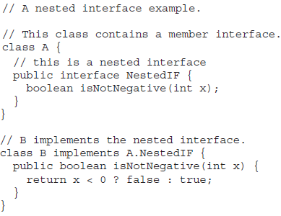
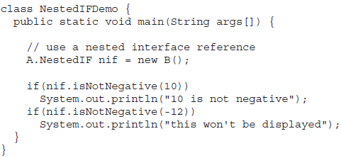
  Nested Interfaces: ...
Notice that the name is fully qualified by the enclosing class’ name. Inside the main( ) method, an A.NestedIF reference called nif is created, and it is assigned a reference to a B object. Because B implements A.NestedIF, this is legal.
.

Slide 46
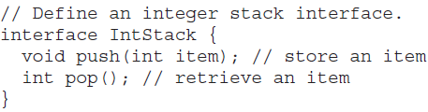
  Applying Interfaces:
The interface to the stack remains the same. That is, the methods push( ) and pop( ) define the interface to the stack independently of the details of the implementation.
Because the interface to a stack is separate from its implementation, it is easy to define a stack interface, leaving it to each implementation to define the specifics.

Slide 47
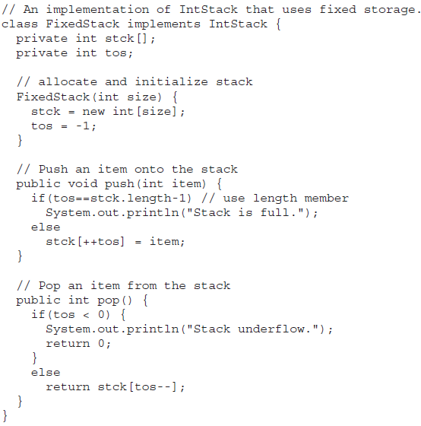
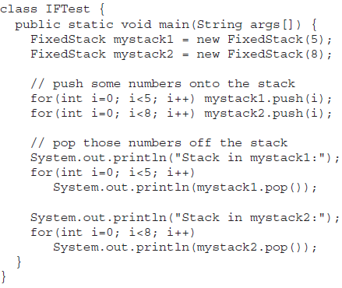
  Applying Interfaces: ...

Slide 48
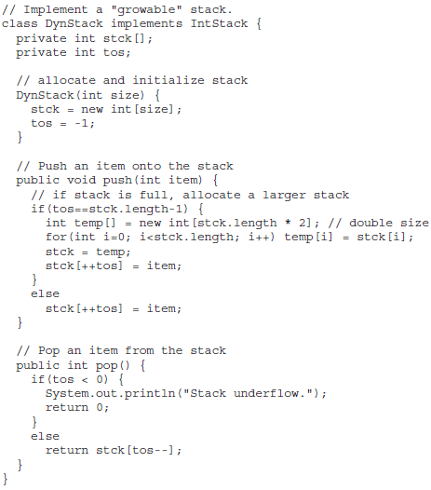
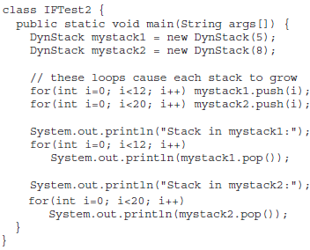
  Applying Interfaces: ...

Slide 49
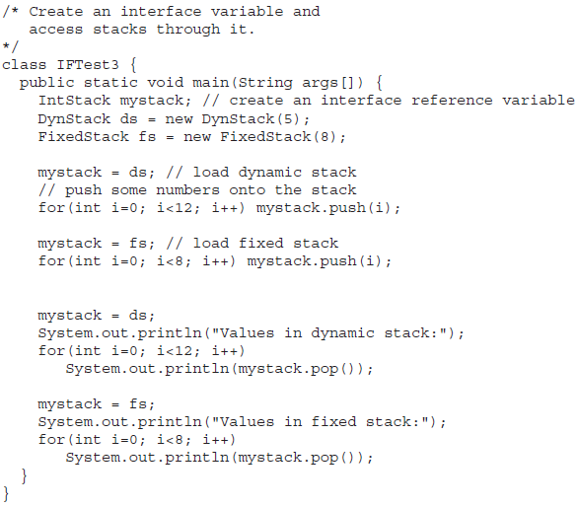
  Applying Interfaces: ...

Slide 50
  Variables in Interfaces:
You can use interfaces to import shared constants into multiple classes by simply declaring an interface that contains variables that are initialized to the desired values. When you include that interface in a class (that is, when you “implement” the interface), all of those variable names will be in scope as constants.
It is as if that class were importing the constant fields into the class name space as final variables.

Slide 51
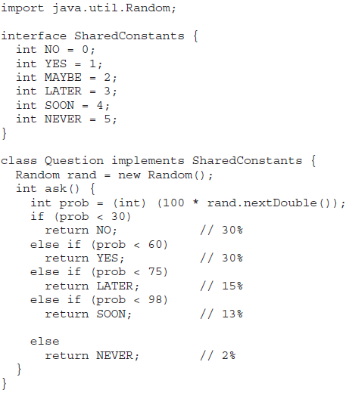
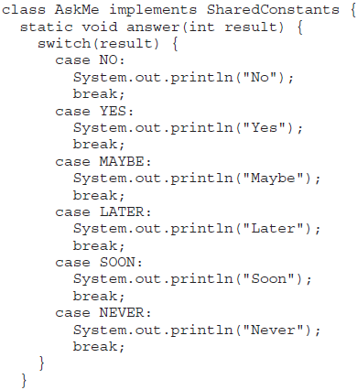
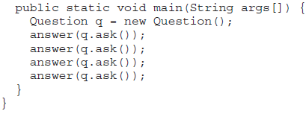
  Variables in Interfaces: ...

Slide 52
  Interfaces Can Be Extended:
One interface can inherit another by use of the keyword extends.
The syntax is the same as for inheriting classes.
When a class implements an interface that inherits another interface, it must provide implementations for all methods defined within the interface inheritance chain.

Slide 53
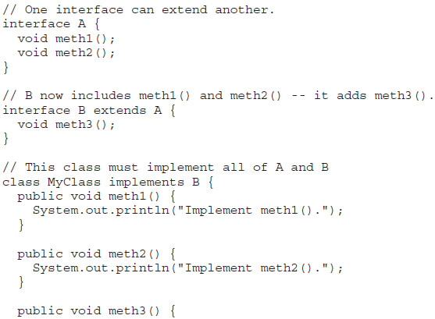
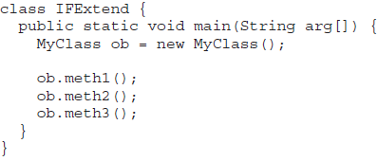

  Interfaces Can Be Extended:

